Slide 1
UNIT-2
NETWORKING TECHNOLOGIES
Contents:
Physical Layer and Transceiver Design Considerations,
Personal area networks (PANs),
Hidden node and Exposed node problem,
Topologies of PANs, MANETs, WANETs.

Slide 2
Physical Layer & Transceiver Design Considerations:
WSNs share many of the problems and challenges of traditional wireless networks, such as
Challenges presented by multipath wireless channels,
Bandwidth
Power constraints
Size and Cost
Memory constraints
In this Chapter, we consider the specific physical layer requirements of WSNs, taking into consideration the particular characteristics and usage setups of WSNs.
Spread spectrum technologies meet the requirements much better than narrowband technologies. Furthermore, Ultra- Wideband technologies are best alternative.

Slide 3
Physical Layer & Transceiver Design Considerations: …cntd
Physical Layer Requirements/ Considerations:
Physical layer is the layer of OSI network model which deals with the physical connectivity of two different stations.
This layer defines the hardware equipment, cabling, wiring, frequencies, pulses used to represent binary signals etc.
Physical layer provides its services to Data-link layer.
physical layer in wireless networked sensors has to be designed with sensor networking requirements in mind.

Slide 4
Physical Layer & Transceiver Design Considerations: …cntd
Physical Layer Requirements/ Considerations:
Nature and complexity of the physical layer – can’t be too complex.
Interference from other devices- Sophisticated noise canceling algorithms to be used.
Link layer and physical layer synchronization- For sensor networks, the link and physical layers must be designed to allow synchronization between communicating nodes.
Capability to re-use radio technology- Excessive interference between sensing and communications signals can be avoided.
Antenna considerations-Antennas should be spaced apart at least 40–50% of the wavelength. Antenna size should be more than the carrier’s wavelength to achieve good antenna efficiency,
Physical layer multicasting- A signal can be sent to multiple receivers at the same time. Desired receivers receives and remaining other will be filtered. Filtering will happens in the protocol stack but it consumes more power.

Slide 5
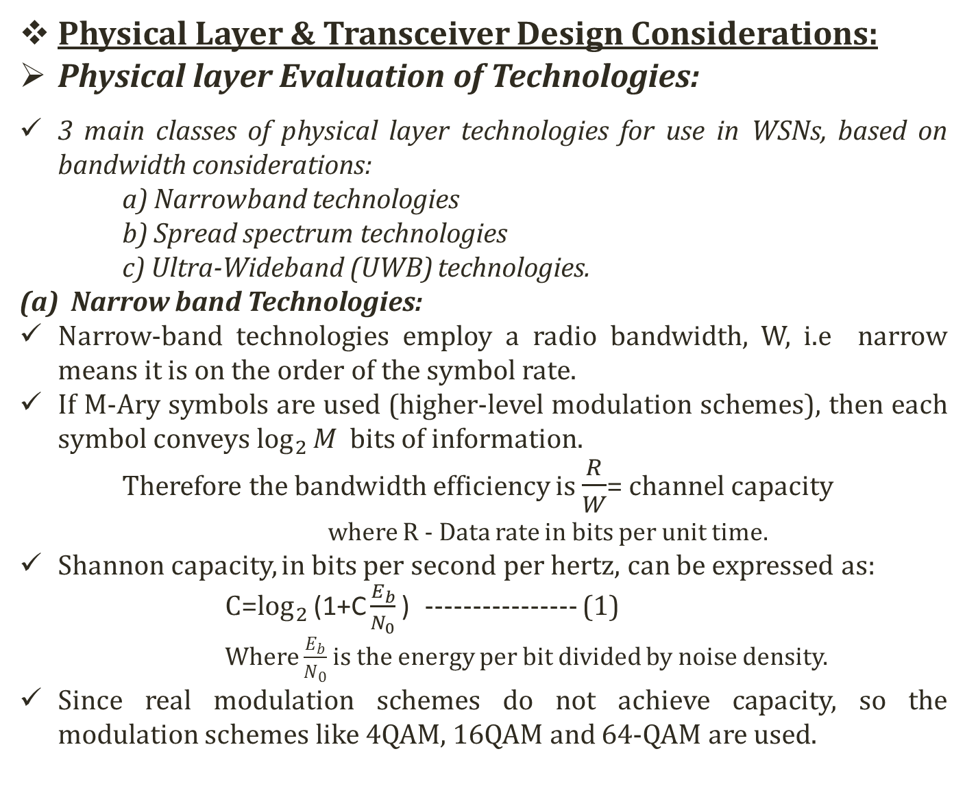
Physical Layer &Transceiver Design Considerations:
Physical layer Evaluation of Technologies:
3 main classes of physical layer technologies for use in WSNs, based on bandwidth considerations:
a) Narrowband technologies
b) Spread spectrum technologies
c) Ultra-Wideband (UWB) technologies.
Narrow band Technologies:
Narrow-band technologies employ a radio bandwidth, W, i.enarrow means it is on the order of the symbol rate.
If M-Arysymbols are used (higher-level modulation schemes), then each symbol conveys $\log_{2}{M}$ bits of information.
Therefore the bandwidth efficiency is $\frac{R}{W}$= channel capacity
where R - Data rate in bits per unit time.
Shannon capacity, in bits per second per hertz, can be expressed as: C=$\log_{2}{\text{(1+}\text{C}\frac{E_{b}}{N_{0}}\text{)}}$---------------- (1)
Where $\frac{E_{b}}{N_{0}}$ is the energy per bit divided by noise density.
Since real modulation schemes do not achieve capacity, so the modulation schemes like 4QAM, 16QAM and 64-QAM are used.

Slide 6
Physical Layer & Transceiver Design Considerations:
Physical layer Evaluation of Technologies:
(b) Spread spectrum technologies:
Spread spectrum is a technique used for transmitting radio or telecommunications signals. i.e spreading the transmitted signal to occupy the frequency spectrum available for transmission.
The advantages of spread spectrum systems over narrow band systems includes
Low probability of detection
Low probability of interrupt
Ability to communicate with low power
Noise-like signals and noise-like interference to other receivers
Robustness to narrow-band interference
Multiple-access to the same frequency band by several transmitters
Robustness to multipath channel impairments
In Direct-Sequence Spread Spectrum (DS-SS) a narrowband signal is “spread” into a wideband signal by modulating with a high rate chip (pseudo-random) sequence.
In Frequency Hopping Spread Spectrum (FH-SS) spreading is achieved by “hopping” the signal over a wide range of frequencies

Slide 7
Physical Layer & Transceiver Design Considerations:
Physical layer Evaluation of Technologies:
(c) Ultra-Wideband (UWB) technologies :
It is an extreme case of spread spectrum technology with many proposed applications in communications. Its characteristics include
Large bandwidths: The transmission bandwidths employed by UWB systems is usually much larger than the transmission bandwidths of typical spread spectrum systems, being on the order of gigahertz rather than megahertz.
(ii) Large fractional bandwidths: UWB systems tend to have relatively larger fractional bandwidths than traditional communications systems.

Slide 8
Physical Layer & Transceiver Design Considerations:
Physical layer Evaluation of Technologies:
Comparison of Physical layer Technologies:
Note: The ratings are on a scale of 1 to 5, with 1 being the worst rating (very poor) and 5 being the best (very good).
S. No | Criterion | Narrow Band | Spread Spectrum | UWB
1 | Device Size | 4 | 4 | 4
2 | Cost | 3 | 3 | 4
3 | Power Consumption | 2 | 4 | 5
4 | Low range, Low data rate | 3 | 4 | 5
5 | Robustness to interference | 1 | 4 | 5
6 | Robustness to Noise | 2 | 4 | 5
7 | Ease of Synchronization | 3 | 5 | 2
8 | Radio Reusability | 2 | 2 | 4
9 | Physical Layer multicast | 1 | 4 | 5
10 | Regularity Issues | 2 | 4 | 3

Slide 9
PERSONAL AREA NETWORK – PAN
Thomas Zimmerman was the first research scientist to introduce the idea of Personal Area Network (PAN).
The communication network established for the purpose of connecting computer devices of personal use is known as PAN (Personal Area Network).
When a network is established by connecting phone lines to PDAs (Personal Digital Assistants), this communication is known as PAN (Personal Area Network).
PANs can be wired (USB or FireWire) or wireless (infrared, ZigBee, Bluetooth, UWB).
Wireless Personal Area Network (WPAN) can perform really efficient operations if we connect them with specialized devices.
The range of a PAN typically is a few meters.
Examples of wireless PAN, or WPAN, devices include cell phone headsets, wireless keyboards, wireless mice, printers, bar code scanners and game consoles.

Slide 10
PERSONAL AREA NETWORK – PAN: …cntd
Examples:
Blue tooth wireless PAN:
These are referred as Pico nets. Pico nets are Ad hoc networks.
Pico nets work over a range of 200metres and transmit data of about 2100 Kbit/ sec.
The Bluetooth technology is based on IEEE 802.15 standard.
The wearable and portable computer devices communicate with each other.
In this process of hand shake, an electric field is generated around people, and they emit Pico amps.
These emissions complete the circuit and hence an exchange of information takes place.

Slide 11
PERSONAL AREA NETWORK – PAN: …cntd
Examples:
2. ZigBee:
It is a short-range, low-power computer networking protocol that complies with the IEEE 802.15.4 standard.
In the U.S., ZigBee devices operate in the 902-928 MHz and 2.4 GHz unlicensed bands.
ZigBee employs DS-SS modulation with a gross data rate of 40 kb/s in the 900 MHz band and 250 kb/s in the 2.4 GHz band.
There are three types of ZigBee devices:
ZigBee Coordinator (ZC): Forming the root of the network tree and bridging to other networks ,
ZigBee Router (ZR): It can run an application function as well as act as an intermediate router by passing data from other devices.
ZigBee End Device (ZED): It contains just enough functionality to talk to its parent node. It can sleep most of the time, extending its battery life.

Slide 12
PERSONAL AREA NETWORK – PAN:
Examples:
3. Ultra-Wide Band(UWB):
It is a radio technology useful for short-range, high-bandwidth communications that does not create harmful interference to users sharing the same band.
A pulse-based UWB method is the basis of the IEEE 802.15.4a draft standard
4. Wi-Fi or WiMAX
Wi-Fi or WiFi is a technology for wireless local area networking with devices based on the IEEE 802.11 standards.

Slide 13
HIDDEN NODE AND EXPOSED NODE PROBLEM:
In WSN, to exchange data two exchange control frames are used before transmitting data
Request to Send(RTS)
Clear to Send(CTS)
RTS/CTS is the optional mechanism used by the 802.11 wireless networking protocol to reduce frame collisions introduced by the hidden node problem.
These control frames duty includes
If sender sees CTS, transmits data.
If other node sees CTS, will idle for specified period.
If other node sees RTS but not CTS, free to send.

Slide 14
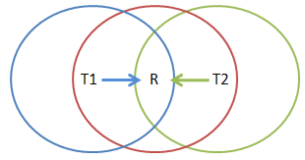
HIDDEN NODE AND EXPOSED NODE PROBLEM: …cntd
Hidden Node/Terminal Problem:
T1 and T2 can’t see each other, both send to R
RTS/CTS can help
Both T1 and T2 would send RTS that R would see first.
R only responds with one CTS (say, echoing T1’s RTS).
T2 detects that CTS doesn’t match and won’t send.

Slide 15
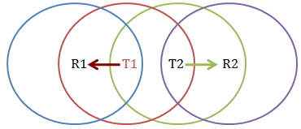
HIDDEN NODE AND EXPOSED NODE PROBLEM:
Exposed Node/Terminal Problem:
T1 sending to R1, T2 wants to send to R2.
As T2 receives packets, carrier sense would prevent it from sending to R2, even though wouldn’t interfere
RTS/CTS can help
T2 hears RTS from T1, but not CTS from R1
T2 knows its transmission will not interfere at T1’s receiver
T2 is safe to transmit to R2.

Slide 16
Mobile Ad-HOC Networks (MANETs):
A Mobile Ad-hoc Network is a collection of independent mobile nodes that can communicate to each other via radio waves.
A mobile ad-hoc network (MANET) is a continuously self-configuring, infrastructure-less network of mobile devices connected wirelessly.
Each device in a MANET is free to move independently in any direction, and will therefore change its links to other devices frequently.
The mobile nodes that are in radio range of each other can directly communicate, whereas others needs the aid of intermediate nodes to route their packets.
Each of the node has a wireless interface to communicate with each other.

Slide 17
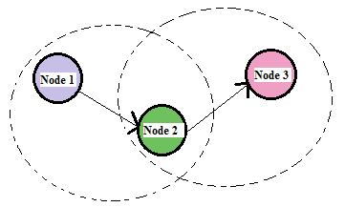
Mobile Ad-HOC Networks (MANETs): ….cntd
Example of MANETs:
Node 1 and node 3 are not within range of each other, however the node 2 can be used to forward packets between node 1and node 2.
The node 2 will act as a router and these three nodes together form an ad-hoc Network.

Slide 18
Mobile Ad-HOC Networks (MANETs): ….cntd
MANETs characteristics :
1) Distributed operation: There is no central control of the network operations, the control of the network is distributed among the nodes.
2) Multi hop routing: When a node tries to send information to other nodes which is out of its range, the packet should be forwarded via one or more intermediate nodes.
3) Autonomous terminal: In MANET, each mobile node is an independent node (could function as host/router).
4) Dynamic topology: Nodes are free to move arbitrarily with different speeds; thus, the network topology may change randomly and at unpredictable time.
5) Light-weight terminals: The nodes at MANET are mobile with less CPU capability, low power storage and small memory size.
6) Shared Physical Medium: The wireless communication medium is accessible to any entity with the appropriate equipment and adequate resources.

Slide 19
Mobile Ad-HOC Networks (MANETs): ….cntd
MANETs Challenges
Limited bandwidth.
Dynamic topology.
Routing Overhead: In wireless ad-hoc networks, nodes often change their location within network. So, some stale routes are generated in the routing table which leads to unnecessary routing overhead.
Hidden terminal problem.
Packet losses due to transmission errors.
Mobility-induced route changes.
Battery constraints.
Security threats.

Slide 20
Mobile Ad-HOC Networks (MANETs): ….cntd
MANET VULNERABILIES: Vulnerability is a weakness in security system.
1)Lack of centralized management.
2) No predefined Boundary: In mobile ad- hoc networks we cannot precisely define a physical boundary of the network.
3) Cooperativeness: Routing algorithm for MANETs usually assumes that nodes are cooperative and non-malicious.
4) Limited power supply: The nodes in mobile ad-hoc network need to consider restricted power supply, which will cause several problems.
5) Adversary inside the Network: The mobile nodes within the MANET can freely join and leave the network. The nodes within network may also behave maliciously.

Slide 21
Mobile Ad-HOC Networks (MANETs): ….cntd
ROUTING PROTOCOLS: Ad-Hoc network routing protocols are commonly divided into 3 classes; Proactive , Reactive and Hybrid protocols.
Proactive Protocols: In proactive routing, each node has to maintain one or more tables to store routing information, and any changes in network topology need to be reflected by propagating updates throughout the network in order to maintain a consistent network view. Example is Destination sequenced distance vector (DSDV).
Reactive Protocols: Reactive routing is also known as on-demand routing protocol since they do not maintain routing information or routing activity at the network nodes if there is no communication. Examples is Ad-hoc On-demand Distance Vector routing (AODV).
Hybrid Protocols: It combines reactive and proactive routing protocols. Example is Zone Routing Protocol (ZRP).

Slide 22
Mobile Ad-HOC Networks (MANETs): ….cntd
Security Attacks in MANETs: The attacks can be categorized into two types based on behavior as Passive or Active attack.
Passive attacks: It does not alter the data transmitted within the network. But it includes the unauthorized “listening” to the network traffic or accumulates/collects data from it.
Active attacks: Active attacks are very severe attacks on the network that prevent message flow between the nodes. They can be internal or external. Active attacks are classified into three groups:
Dropping Attacks: Compromised nodes or selfish nodes can drop all packets that are not destined for them.
Modification Attacks:. These attacks modify packets and disturb the overall communication between network nodes.
Fabrication Attacks: In this attacker send fake message to the neighbouring nodes without receiving any related message.

Slide 23
Mobile Ad-HOC Networks (MANETs): ….cntd
MANETs Applications:
Military battlefield: Ad-Hoc networking would allow the advantage of commonplace network technology to maintain an information network between the soldiers, vehicles.
Collaborative work: For some business environments, the outside meetings are important to cooperate and exchange information on a given project.
Local level: Ad-Hoc networks can autonomously link an instant and temporary multimedia network using notebook computers to spread and share information among participants.
Personal Area Network and Bluetooth.
Commercial Sector: Ad-hoc can be used in emergency or rescue operations for disaster relief efforts.

Slide 24
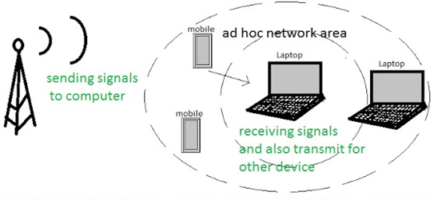
Wireless Ad-HOC Networks (WANETs):
Wireless ad hoc network (WANET) is a decentralized technology designed for the establishment of a network anywhere and anytime without any fixed infrastructure to support the mobility of the users in the network .
The network is ad-hoc because each node is willing to forward data for other nodes.

Slide 25
Wireless Ad-HOC Networks (WANETs): ….cntd
Wireless ad-hoc networks can be further classified by their application:
Mobile ad hoc networks (MANETs): MANET is a continuously self-configuring, infrastructure-less network of mobile devices connected without wires.
Vehicular ad hoc networks (VANETs): VANETs are used for communication between vehicles and roadside equipment.
. Intelligent vehicular ad hoc networks: InVANETs are a kind of artificial intelligence that helps vehicles to behave in intelligent manners during vehicle-to-vehicle collisions, accidents. Vehicles are using radio waves to communicate with each other
SmartPhone Ad-hoc networks (SPANs): SPANs influence the existing hardware (primarily Bluetooth and Wi-Fi) in commercially available smartphones to create peer-to-peer networks without depends on cellular carrier networks, wireless access points, or traditional network infrastructure.
internet-based Mobile Ad-hoc networks (iMANETs): iMANETs are ad hoc networks that link mobile nodes and fixed Internet-gateway nodes.

Slide 26
Wireless Ad-HOC Networks (WANETs): ….cntd
VANET:

Slide 27
Wireless Ad-HOC Networks (WANETs): ….cntd
VANET: smart vehicle

Slide 28
Wireless Ad-HOC Networks (WANETs): ….cntd
VANET: smart vehicle
EDR – Used in vehicles to register all important parameters, such as velocity, acceleration, etc. especially during abnormal situations (accidents)
Forward radar – Used to detect any forward obstacles as far as 200 meters
Positioning System – Used to locate vehicles
Computing platform – Inputs from various components are used to generate useful information

